Slide 1
Youtube chanel

Slide 2
Target audience
People intersted in travelling in small budget
People intersted to travel to new distanation

Slide 3
Ultime goal
Open our online travel agency

Slide 4
What we need to start
Search for hiding spaces all over the world
Search for non pricy hotels for our followers

Slide 5
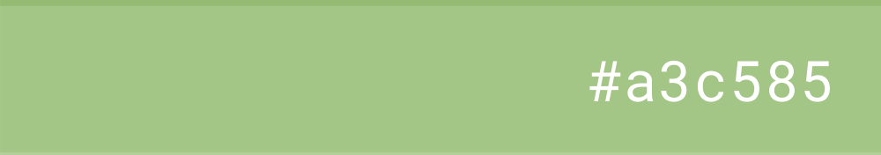
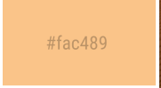
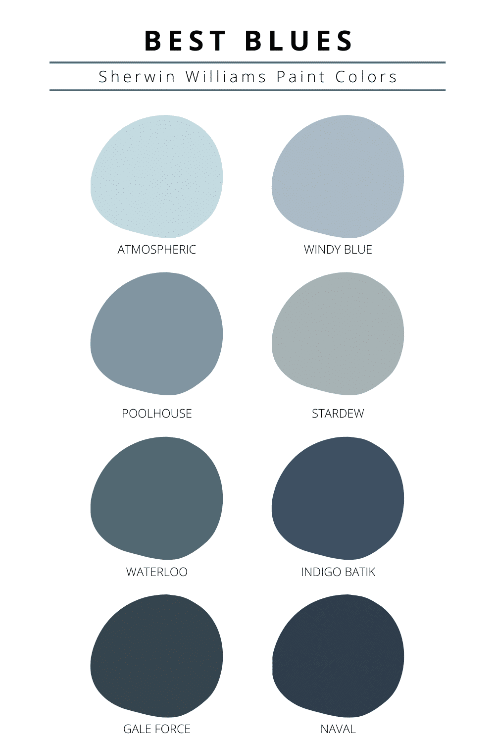
branding
Color palette

Slide 6
Name ideas
Safer سافر
Old suitcase

